Slide 1
AM
1375003
KyungSil Kim
ks_tina@naver.com
Department of Electronics Engineering
Ewha Womans University

Slide 2
Modulation & Demodulation
Modulation
  The process of combining the low-frequency signal with a very high-frequency radio wave (carrier wave).
  The resultant wave is called modulated carrier wave.
  This job is done at the transmitting station.
Demodulation
  The process of separating or recovering signal from the modulated carrier wave.
  Opposite of modulation and is performed at the receiving end.

Slide 3
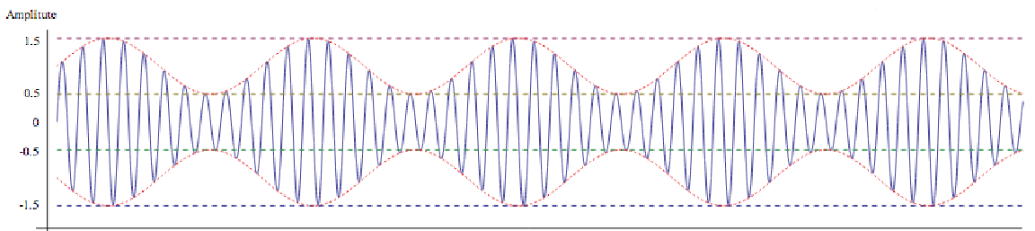
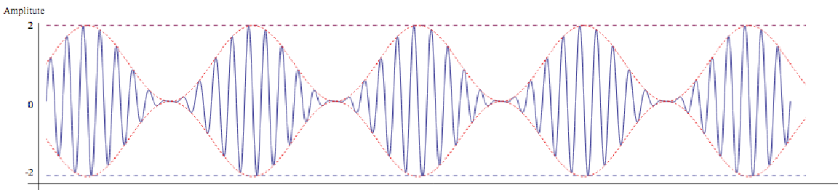
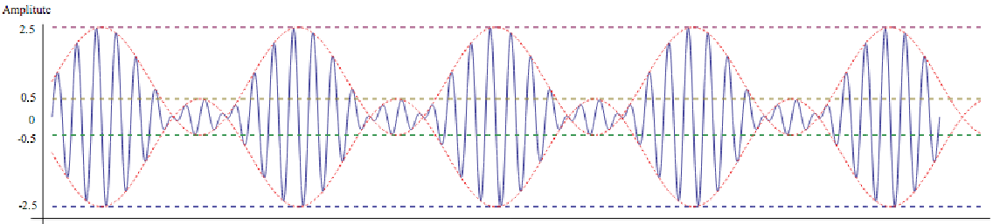
Which can be easily demodulated or not?

Slide 4
Which can be easily demodulated or not?
1
2

Slide 5

Which can be easily demodulated or not?
Modulation index µ = $\frac{modulation amplitude}{carrier amplitude}$
= $\frac{0.5}{1}$ = 0.5
1

Slide 6

Which can be easily demodulated or not?
Modulation index µ = $\frac{modulation amplitude}{carrier amplitude}$
= $\frac{1}{1}$ = 1
2

Slide 7

Which can be easily demodulated or not?
Modulation index µ = $\frac{modulation amplitude}{carrier amplitude}$
= $\frac{1.5}{1}$ = 1.5
Carrier exhibits phase reversal

Slide 8
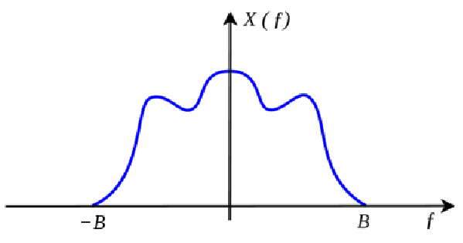

Roughly draw the resulting frequency components of AM modulated signal
${f(t)cosω}_{c}t$
$ω_{c}≫β$
use the modulation property of the Fourier transform

Slide 9
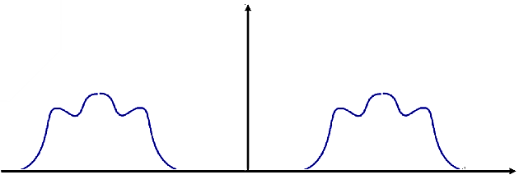
Roughly draw the resulting frequency components of AM modulated signal

